Slide 1
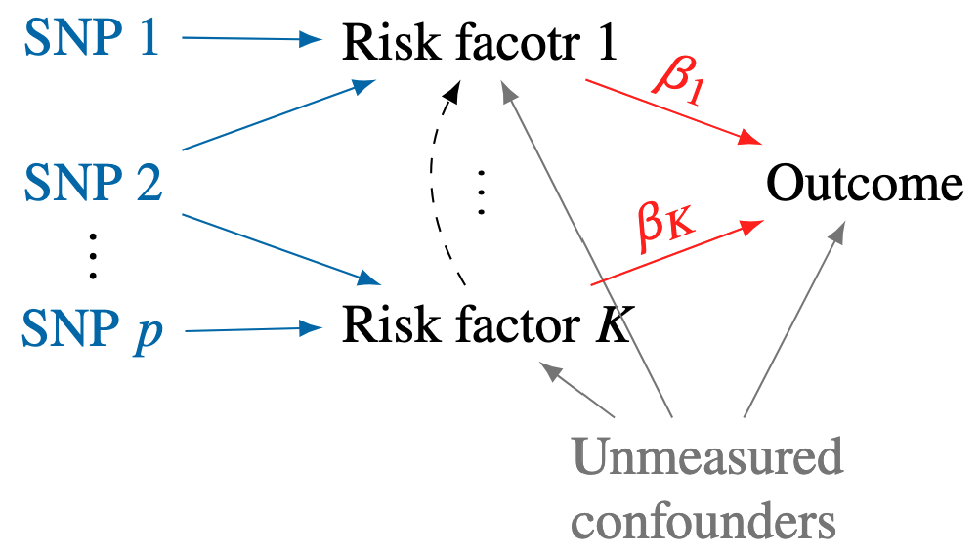
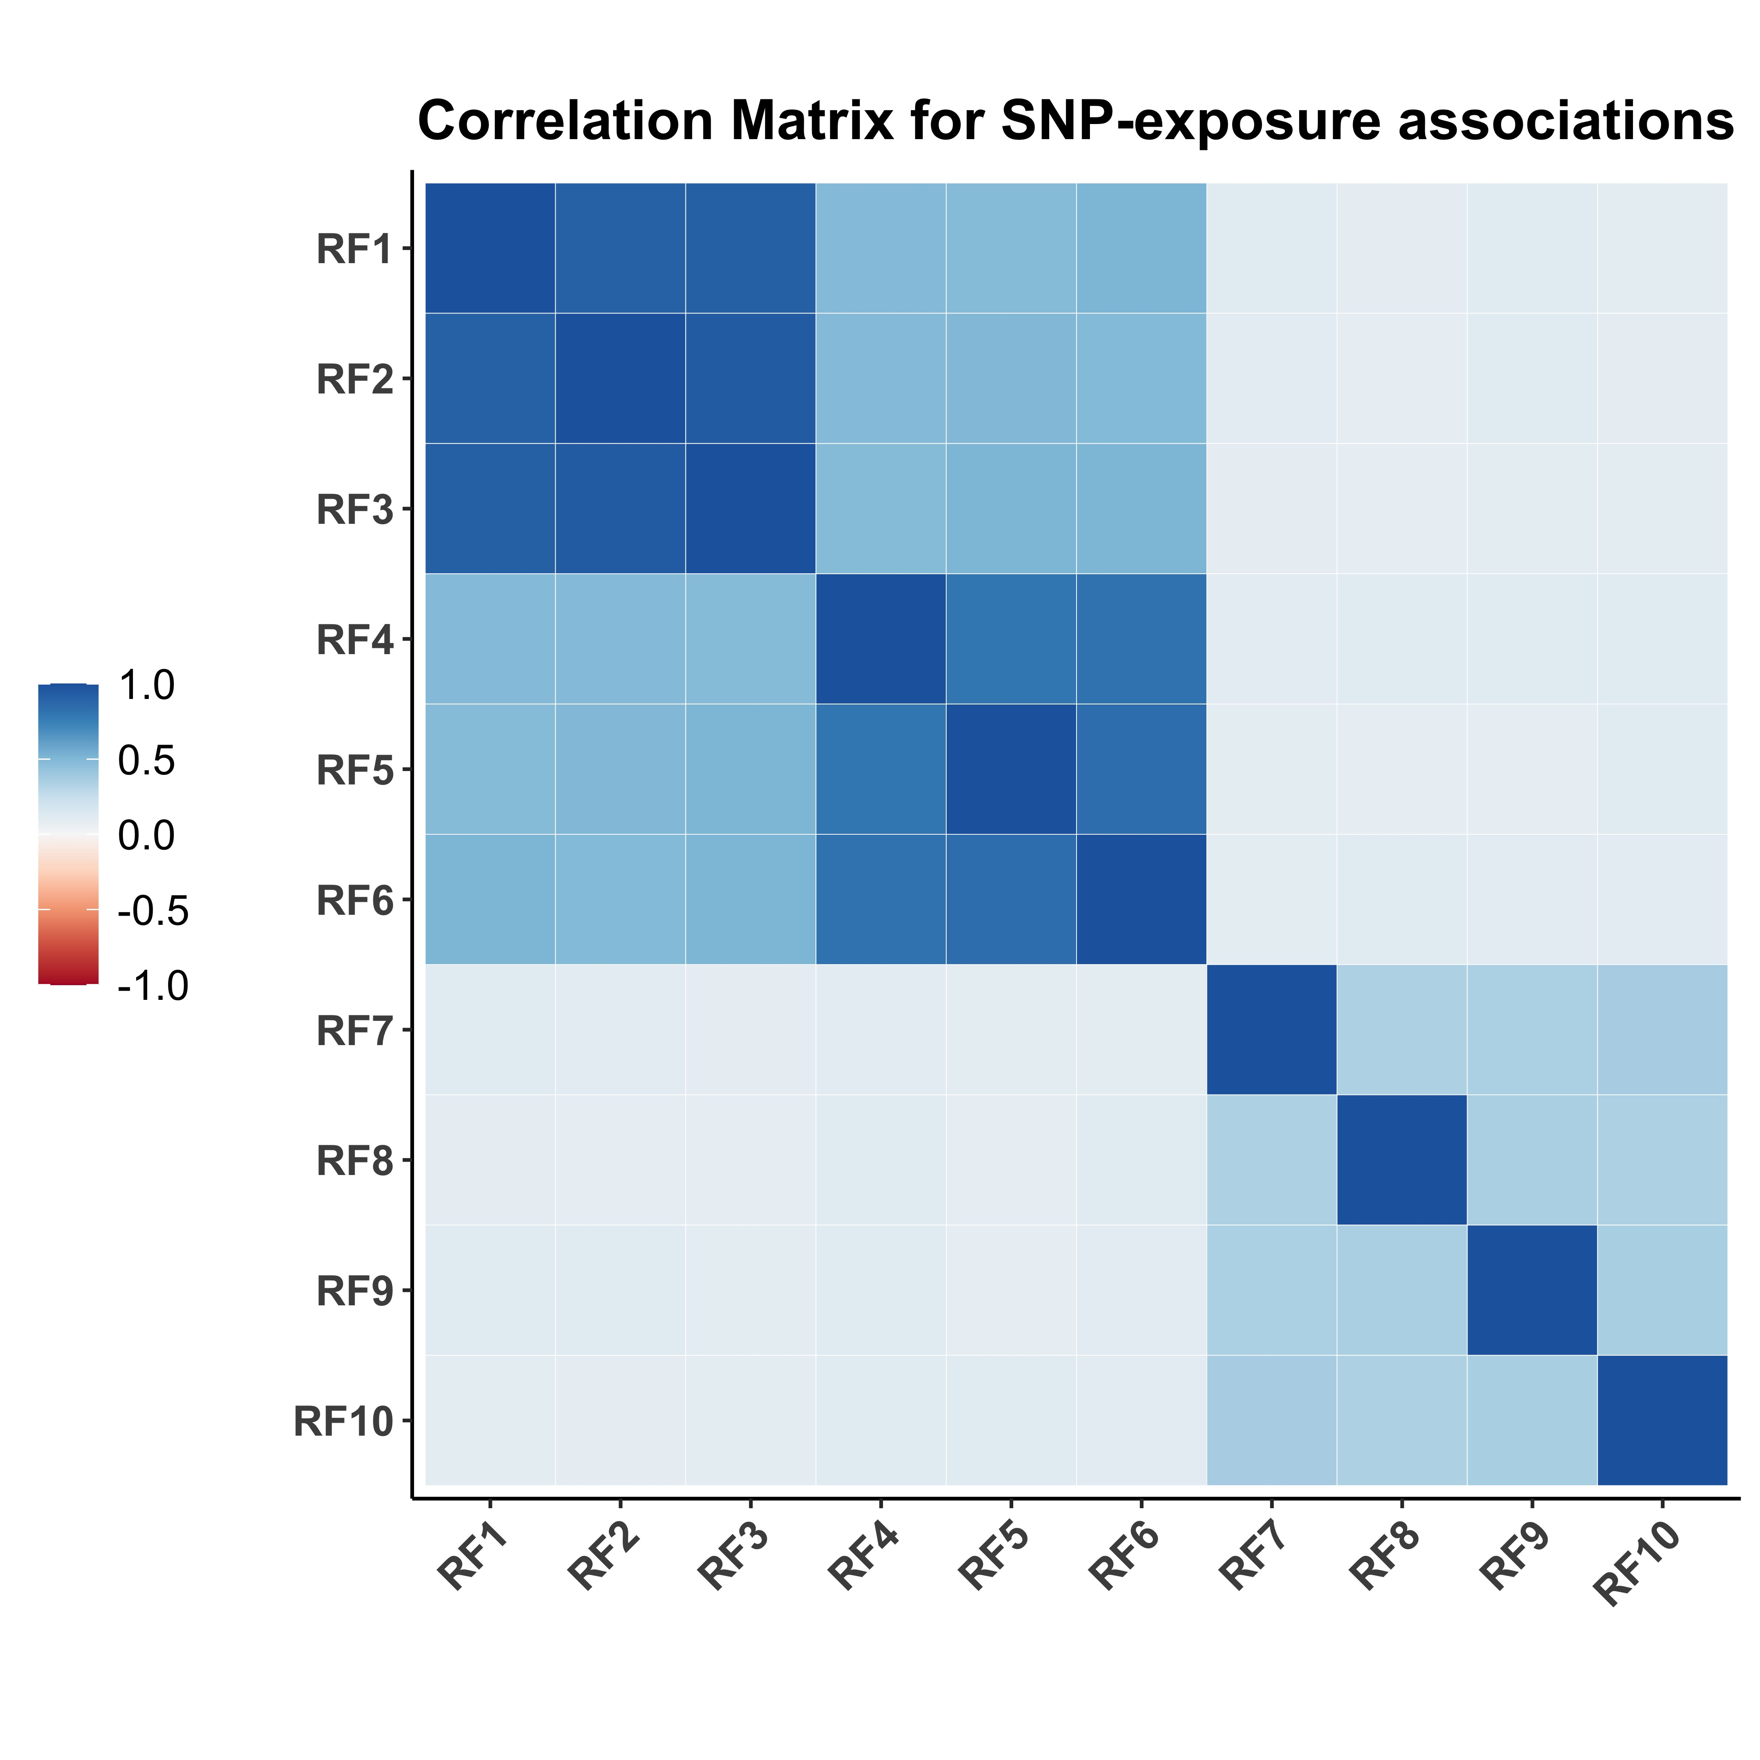
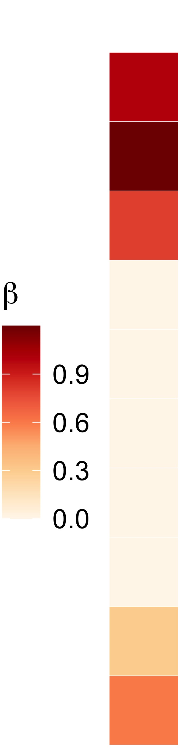
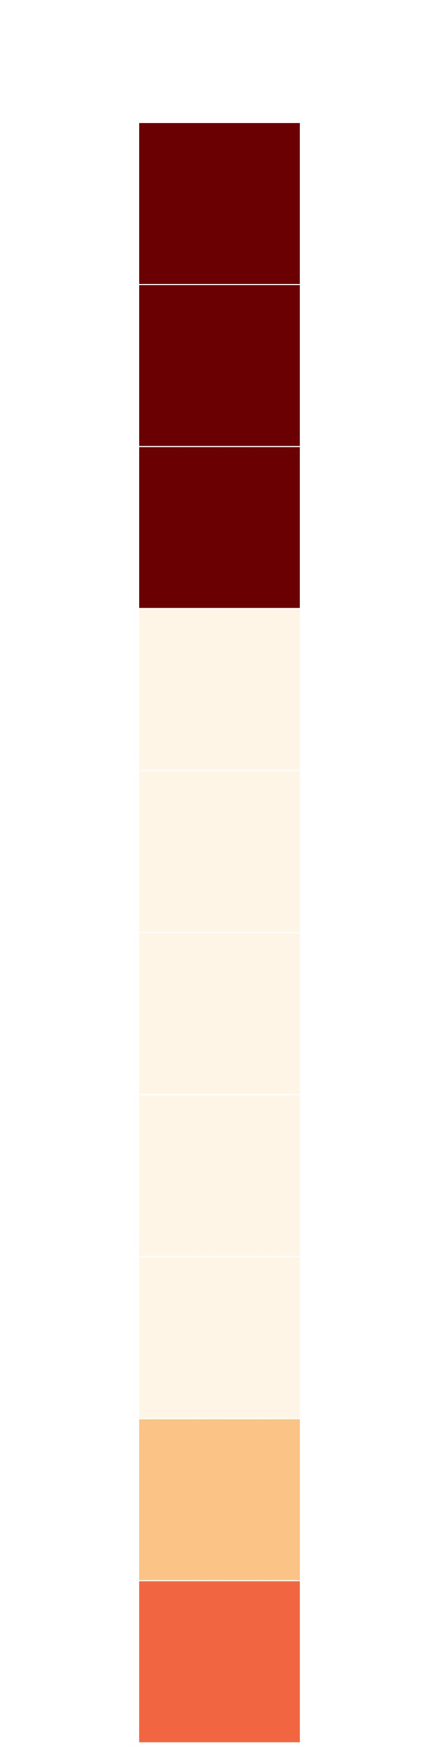









(a)
Causal Diagram
(d)
Data thinning for MVMR
Summary data $\left({\hat{γ}}_{j},{\hat{Γ}}_{j}, Σ_{Xj},σ_{Yj}^{2}\right), j=1,…,p$
Data copy 1
$$\left({\hat{γ}}_{j}^{(1)},{\hat{Γ}}_{j}^{(1)}, Σ_{Xj}^{(1)},{σ_{Yj}^{2}}^{(1)}\right)$$
Data copy 2
$$\left({\hat{γ}}_{j}^{(2)},{\hat{Γ}}_{j}^{(2)}, Σ_{Xj}^{(2)},{σ_{Yj}^{2}}^{(2)}\right)$$
$$⊥$$
(b)
GWAS summary statistics
MVMR-PACS
SRIVW
P< 5e-8 with at least one risk factor
Identify causal risk factors and grouping
Signal-groups:
G₁ = (RF₁ + RF₂ + RF₃)
G₂ = (RF₄ - RF₅)
$$…$$
G_{L} = (RF_{K-1}+RF_{K})
Estimate causal effects of signal-groups G₁,G₂,…,G_{L}
Enlarged IV strength after grouping
Valid confidence intervals
p SNPs
LD-based clumping
Exposure datasets
Outcome dataset
${\hat{γ}}_{jk}$: SNP j
Risk factor k
${\hat{Γ}}_{j}$: SNP j
Outcome
(c)
MVMR-PACS for causal risk factor and signal-group identification
$$β^{∗}$$
$${\hat{β}}_{PACS}$$
Signal-group1
MVMR-PACS
Grouping based on
Correlation structure
True causal effects
non-causal group
Signal-group2
Signal-group3

Slide 2





Data thinning for MVMR
Summary data $\left({\hat{γ}}_{j},{\hat{Γ}}_{j}, Σ_{Xj},σ_{Yj}^{2}\right), j=1,…,p$
Data copy 1
$$\left({\hat{γ}}_{j}^{(1)},{\hat{Γ}}_{j}^{(1)}, Σ_{Xj}^{(1)},{σ_{Yj}^{2}}^{(1)}\right)$$
Data copy 2
$$\left({\hat{γ}}_{j}^{(2)},{\hat{Γ}}_{j}^{(2)}, Σ_{Xj}^{(2)},{σ_{Yj}^{2}}^{(2)}\right)$$
$$⊥$$
MVMR-PACS
SRIVW
Identify causal risk factors and grouping
Signal-groups:
G₁ = (RF₁ + RF₂ + RF₃)
G₂ = (RF₄ - RF₅)
$$…$$
G_{L} = (RF_{K-1}+RF_{K})
Estimate causal effects of signal-groups G₁,G₂,…,G_{L}
Enlarged IV strength after grouping
Valid confidence intervals

Slide 3
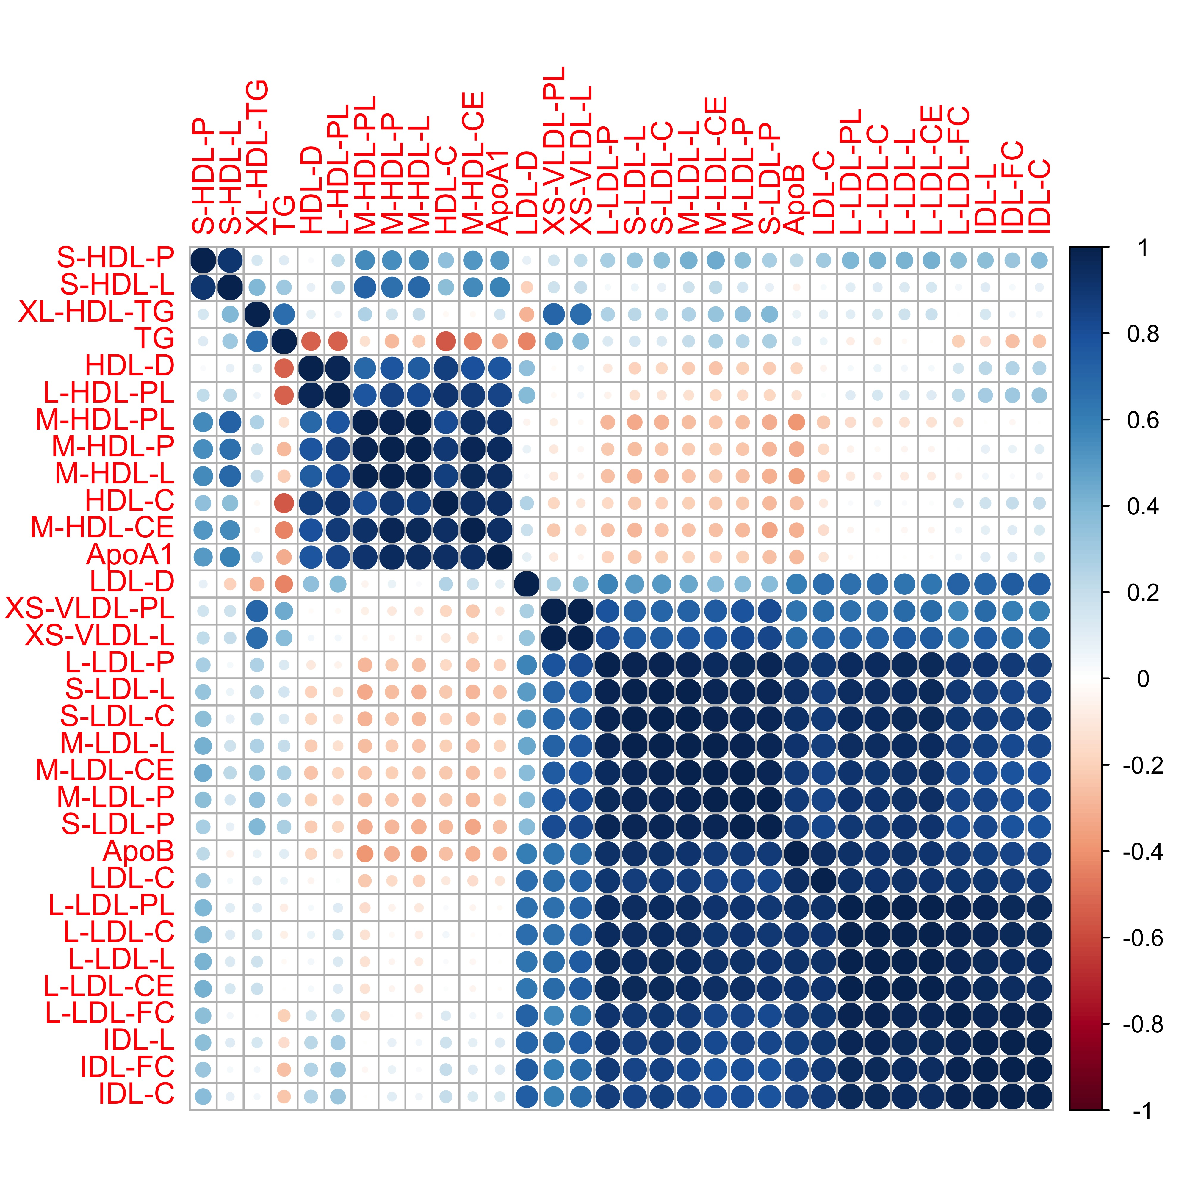
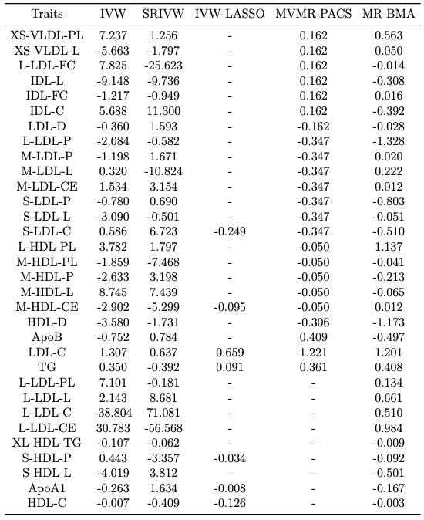
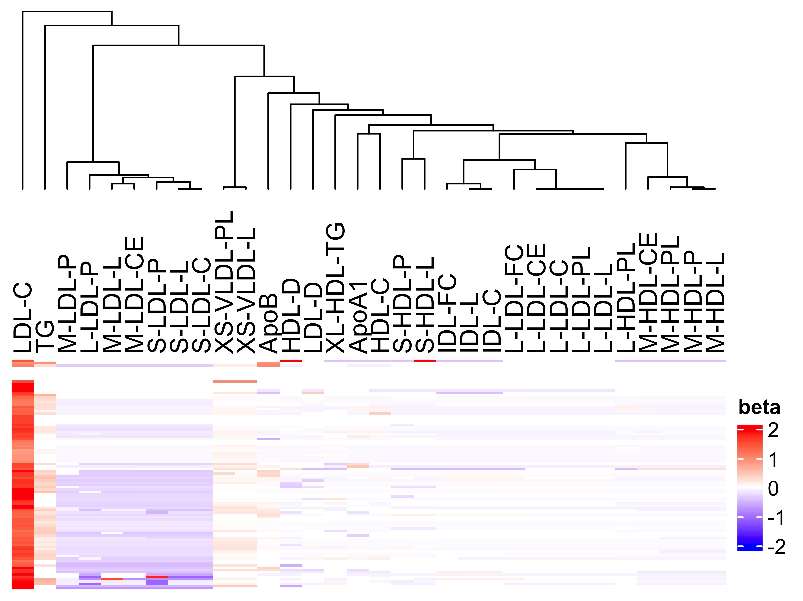
(a)
(b)
(c)

